Slide 1
How Things Work: Linux
Extending Linux
@khenidak

Slide 2

you are here
Processes + IPC
FS + Block Dev
I/O
Networking 1
Networking 2
Containers
Building Linux
Extending Linux
Where we are. Where we are going. https://aka.ms/k8s/howthingswork https://github.com/khenidak/on-linux

Slide 3
Why are Here Today
Extending Linux is the function of either making Linux doing something it didn’t do before (e.g., a new storage device driver with different backing system) or making it do something it knows how to do but a little differently (e.g., slightly different networking data plane) and everything in between.
But Why? It is either a requirements of what you run and how you run it (e.g., high density container deployment) or a requirements of where you run it (e.g., virtual infrastructure) and everything in between (e.g., instrumenting a specific syscall for audit/security/perf-analysis etc.)
In context: What do we not consider as “extending”? Composing extending existing capabilities into a “new thing” (e.g., containers in their current form)

Slide 4
How are we approaching today’s topic
We will approach it bottom up starting from kernel space to user space. Most of what will be said today is something we talked – at least a little – about before.
Due to the density of the materials, we will not go deep in every topic. E.g., this is not ”how to ebpf” session. But rather how ebpf work, at a super highlevel.
This session does not cover *all* of the possibilities, but we will try to cover the most common one and at least mention/list the rest.

Slide 5
Extending Linux: Kernel Space
Patches and Modules

Slide 6
Kernel Private Patches
The easiest yet the most operationally expensive is to carry private patches. They are expensive to maintain because you will:
Qualify them by testing them with every new kernel release.
Apply them on every kernel build.
Why do we do them?
Carrying the patch temporarily: Carrying a private patch for something that is yet to hit mainline. Typically carried for a period then dropped once upstream’s mainline is released with the patch. This could be a bug fix, an embargoed CVE etc.
Carrying the patch forever: This is the result of a specific customization for a specific system that can’t be made upstream (or have been proposed and rejected upstream). That patch can be core (e.g., modifying memory management) or can be a module that is rejected from upstream (such as btrfs).
Remember that kernel builds are (kernel, modules, initramfs/initrd) If your patch is targeting a module, then you may as well build core image without the module, then build the module separately then load it using insmod. This should minimize the maintenance effort.
Working with patches
Creating a patch git diff --oneline --graph <source>..<feature branch>
Applying a patch is as simple as patch -p1 < ../patch-x.y.z
Reverting a patch -R -p1 < ../patch-x.y.z
General notes on patch management:
Maintain a master <source> branch that is a mirror of upstream master’s. Frequently rebase your <feature> branch on <source> branch to early detect merge conflicts. It is a common practice not to build the branch but instead create a new branch and apply the patch on*.
Git hygiene is super important. The commit’s order, their structure, their messages becomes handy in understanding where things went wrong.
Automate automate automate. Using a nested virtualization on azure and whatever CI you desire you can automate a 100% of the patching operation and intervene only when needed (e.g., merge conflicts).
RTFM before you start patch tool and git tool

Slide 7
Kernel Modules
Loadable Kernel Modules are code that is built and linked to kernel symbol table (exposed here: /proc/ksyms). They run in kernel space and because of that they can do great many things, but their faults are irrecoverable kernel panics.
At a high level:
Understand kernel facilities: Kernel offers many common facilities such as mem allocator, slab allocator, leak detectors, work queue management, threading, linked lists, RB trees etc.
Understand the kernel area that you want to work with: For example, working with vfs is very different from working with blkdev which is very different from working with networking subsystem even when they all use the same exact kernel facilities.
In a lot of ways, a custom loadable kernel module is your logic based on kernel facilities that integrates with existing (e.g., vfs, net, blkdev etc) interfaces.
Basic How To:
Download the C header files for your current kernel version (and build essentials). Most if not all distros offer headers as an installable package. Then:
#include <linux/init.h> #include <linux/module.h> #include <linux/kernel.h>
MODULE_LICENSE(“GPL”); MODULE_AUTHOR(“Robert W. Oliver II from https://blog.sourcerer.io/writing-a-simple-linux-kernel-module-d9dc3762c234”); MODULE_DESCRIPTION(“A simple example Linux module.”); MODULE_VERSION(“0.01”);
static int __init lkm_example_init(void) { printk(KERN_INFO “Hello, World!\n”); return 0; }
static void __exit lkm_example_exit(void) { printk(KERN_INFO “Goodbye, World!\n”); }
module_init(lkm_example_init); module_exit(lkm_example_exit);

Slide 8
Building + Installing Kernel Modules
Create a make file (generates xx.ko file)
obj-m += lkm_example.o
all: make -C /lib/modules/$(shell uname -r)/build M=$(PWD) modules
clean: make -C /lib/modules/$(shell uname -r)/build M=$(PWD) clean
Install module via insmod xx.ko
Check if installed via lsmod | grep xx
Uninstall mod via rmmod xx
Keep in mind that “uninstall” is not exactly clean uninstall.

Slide 9
Notes on Tainting The Kernel
The kernel taint is a two states state machine where the second state “tainted” can’t be undone without restarting the machine.
A taint is an indication of an out of tree module load (including proprietary non-GPL compatible ones) but can also indicate many other related conditions. Kernel’s /proc/sys/kernel/tainted is a file that bitmap where each bit represents a condition. The value meaning (and how to quickly decode them) can be found here: https://www.kernel.org/doc/html/latest/admin-guide/tainted-kernels.html
Taint is not really a mark of shame (yet it sounds as one). It is meant to help debugging OOPS/BUG conditions sort of ”it wasn’t me. It is you!” message.

Slide 10
Notes on Kernel Module Compatibility
Kernel makes a strong guarantee on the stability of the syscall interface. Meaning, user apps will not break between kernel releases and no recompilation needed to move the app to a new kernel version.
However, it makes zero guarantees about the internals of kernel space. That means while creating a kernel module can be relatively easy. Ensuring that this kernel module works against all supported/target kernel versions can be a lot of work.
There are three schools of thoughts on that:
School 1:
Qualify the module for every kernel release. Use LINUX_VERSION_CODE and KERNEL_VERSION(…) macros to #ifdef around the problem (or utsrelease.h approach on relatively recent kernels) OR
Package multiple kernel ko files in your package and install according to kernel version.
This works best if the module author is engaged with the upstream community and following the progression of the various apis that are considered for change for the upcoming releases.
School 2 (redhat):
Redhat maintains a list of internal kernel api that they guarantee stability between releases. Allowing their own teams (and partner teams) to write modules that will not break between releases as long as you use their own version of the api. This is scoped on to RHEL AFIAK*.
School 3: Don’t ☺

Slide 11
Extending Linux: Kernel Space
eBPF

Slide 12
Why eBPF
Kernel Modules come with a very heavy baggage. They run in kernel space with absolutely no control over what they can and can not do. Loading a kernel module is not just about trusting the code from a security standpoint it is also about trusting the reliability giving that they have access on everything.
Most “extending” effort is about plugging into the kernel processing pipeline of various things be it a syscall, packet flows, IO flow etc. There are some things that must be done as kernel modules but most of the things want to run in kernel space but they are not concerned with domains/areas beyond a very well-defined scope.
eBPF is based on BPF. You can read thru the history but the basic idea is you have the following options from “extending” standpoint:
Full on kernel modules or kernel patch
Bypassing the entire kernel (e.g., userspace tcp-ip stack or oomd style bypass).
eBPF is somewhere in the middle.

Slide 13
Contrasting eBPF to Kernel Modules
Kernel Modules are compiled machine instructions that are dynamically loaded and linked to kernel executable. eBPFs are bytecode objects that are JIT-ed then verified then dynamically linked into the kernel.
Kernel Modules support background processing (threads, work-queues etc). With two entry points functions init/uninit style state machine (again not as clean as it sounds) eBPF programs are edge triggered on predefined events. eBPF programs can’t link to kernel instead kernel link to them (mostly). All communication are styled as return op-codes. They can’t do things like background processing they are verified to ensure memory assertions; correct mem-span reads/writes and against unbounded loops (so yeah you can’t do stuff like walking a variable depth btree).
Kernel modules offer communication to userspace via ioctl, network socket/socket-pairs, or a custom syscall registration (never do that). eBPF programs depend on a set of data structures specifically fixed length maps and arrays. These data structures can be dynamically or statically created and outlive a program run and are accessible from userspace via bpf(2) syscall. A common use case is a ticker that ticks on each event adding an entry to an array where userspace reads it from userspace to rollup and send the ticker telemetry to your favorite observability system (IOW a ring buffer).
Kernel Modules (at least as of today) can only be written in C. eBPF is a bytecode that can be generated by llvm backend. While C is currently the only properly supported language there is nothing stopping us from supporting any other language there (via a custom llvm backend).
Kernel modules would panic the entire kernel if they faulted. eBPF programs will not (at least it is really, really hard to do it).
ebpf can be safely unloaded (because they are triggers, they really don’t engage in anything beyond what they are triggered on). When unloading a kernel module, you can’t really tell if there are lose ends needs to be tied (e.g., inflight io requests, packets, etc)

Slide 14
Putting it all together
?
(kernel header, libbpf CO-RE, …)
Userspace Prog
link
Write (linked to glibc or ...)
Write
Kernel Space
?
Build
llvm
State (maps/arrays)
Built Object
trigger
ebpf(2)
Run
api
Load it
ebpf program
ebpf(2) ++

Slide 15
Where can Linux run eBPF
Networking:
As XDP programs (ingress only as of now) offloaded to NIC or as part of the kernel
As part of Linux TC.
Attached on a socket.
Probes
Kprobes triggered when kernel execute a specific function.
Uprobes triggered when a specific function in a userspace executable is called.
Trace-points
Kernel provide a facility for kernel modules to expose traces. The author of the modules *must* trigger the trace point. The trace data structure is specific to the trace point. Thus, not all trace points are the same nor are available in every kernel. You can find your config here /sys/kernel/debug/tracing/events
Trace points must be enabled for your program to be triggered using tracefs.
What can you do in a bpf program?
Observability style counters via writing to a map/array then reading it from userspace.
Capturing/Rewriting/encap/decap packets (including dropping/redirecting). Examples
O(1) LB via rules read from a map (written to by a userspace program that monitors the health of backing endpoints).
O(1) firewall and tunnels (rules etc are typically saved in a map written to by userspace program).
Syscall re-writing, profiling, filtering via kprobes (in-fact secomp works exactly like that)
Perf analysis

Slide 16
The many ways of using BPF
Via BCC (https://github.com/iovisor/bcc)
Mainly a cli tool to quickly create probes and gather perf data.
Have not yet proved useful to develop your own ebpf programs.
Perf tool
A cli tool (part of linux upstream) where you can quickly hook to trace points and gather counters.
Via a higher-level LSM sub-system such as seccomp or (relatively new-ish) KRSI (https://lwn.net/Articles/808048/)
Indirectly via tooling such as tcpdump
Custom ebpf programs such as
Facebook’s Katran LB https://engineering.fb.com/2018/05/22/open-source/open-sourcing-katran-a-scalable-network-load-balancer/
Cilium CNI https://cilium.io/
Your own..

Slide 17
Extending Linux: User Space
Block Devices and File Systems

Slide 18
But Why? How?
Complexity: Building kernel modules and bpf programs is not exactly easy. Getting them right is one them. Maintaining compatibility with kernel evolution is *a lot* of work.
Runtime governance: it is not possible (as of yet) to limit resources that are used by a kernel module or a bpf program beyond programming discipline.
Easy of use: a userspace program is naturally easy to install, run, operate and upgrade. They fit naturally within existing systems users already know.
The story of userspace v kernel space performance: It might be true that code that runs in kernel space is more performant (avoids context switching, syscall boundaries etc..). But that absolute does not apply on everything and it assumes that performance is the most important element (if not the only important element).
How?
Full/Partial Replace: Turning off the kernel component or limit its scope.
Full Bypass: Kernel is still operating normally but data is sniffed from H/W before they reach kernel processing stages.
Partial Bypass: A kernel module that depends on a userspace component.
Hooks: a kernel module that can interact with a userspace component via shared memory or other means.

Slide 19
oomd
OOM-killer is a kernel background operation that wakes up when memory allocation by app or kernel fails (that includes trying the usual avenues* before failing).
Processes are given a score by the server operator that goes from “do-not-oom-kill” to ”this-is-the-proc-i-am-willing-to-sacrifice-the-most”. The settings are in /proc/<pid>/oom_score_adj file.
The limitation (context really, really matter here):
The settings are absolute. It really does not depend on any context other than static assignment. Most probable use is for users to kill non-essential-side-car.
Apps running in mem-cgroups will be oom-ed if they allocated more than cgroup allotted mem quota, while most probably you want to kill *other* apps in the cgroup not the one trying to allocate more (assuming that this one is the main app in the cgroup). The core assumption here is most apps doesn’t really know how to deal with malloc() == NULL some do, but it is not common. Best case scenario applications just unwind the stack –which may entail more mem, e.g. golang defer or C goto statements - and exits.
OOM killer weighted heuristics may yield into kill the wrong app (any app that is not excluded is a fair game for OOM-killer). Keep in mind that OOM-Killer is not meant to protect you but to protect the stability of the OS.
OOM-killer is kill-now, ask questions later approach. Instead of a graceful approaches such as send kill notification then kill approach. Why?
OOM-killer does not proactively notify processes that something is about to go wrong, and they should yield memory they don’t use back to the system
How:
Either exclude parts of the system or turn oom-killer off completely.
Roll your own oomd (systemd has its own userspace oomd). This is a replace/partial replace.
The kernel does *not* send OOM notification to any userspace app. Your oomd will need to proactively monitor the mem usage of the procs it operate on. This is where Pressure Stall Information comes handy. PSI is a file /proc/pressure/{memory,io, cpu} that gives readout for some || all procs that has stalled waiting for one of these resources over the last 10,60, and 300 ms. The file can be epoll(2) and read as needed. The idea is to use this information to predict ”oh oh, we are going to be in trouble”. When using cgroups2 the file is also available per cgroup.

Slide 20
oomd
OOM-killer is a kernel background operation that wakes up when memory allocation by app or kernel fails (that includes trying the usual avenues* before failing).
Processes are given a score by the server operator that goes from “do-not-oom-kill” to ”this-is-the-proc-i-am-willing-to-sacrifice-the-most”. The settings are in /proc/<pid>/oom_score_adj file.
The limitation (context really, really matter here):
The settings are absolute. It really does not depend on any context other than static assignment. Most probable use is for users to kill non-essential-side-car.
Apps running in mem-cgroups will be oom-ed if they allocated more than cgroup allotted mem quota, while most probably you want to kill *other* apps in the cgroup not the one trying to allocate more (assuming that this one is the main app in the cgroup). The core assumption here is most apps doesn’t really know how to deal with malloc() == NULL some do, but it is not common. Best case scenario applications just unwind the stack –which may entail more mem, e.g. golang defer or C goto statements - and exits.
OOM killer weighted heuristics may yield into kill the wrong app (any app that is not excluded is a fair game for OOM-killer). Keep in mind that OOM-Killer is not meant to protect you but to protect the stability of the OS.
OOM-killer is kill-now, ask questions later approach. Instead of a graceful approaches such as send kill notification then kill approach. Why?
OOM-killer does not proactively notify processes that something is about to go wrong, and they should yield memory they don’t use back to the system
How:
Either exclude parts of the system or turn oom-killer off completely.
Roll your own oomd (systemd has its own userspace oomd). This is a replace/partial replace.
The kernel does *not* send OOM notification to any userspace app. Your oomd will need to proactively monitor the mem usage of the procs it operate on. This is where Pressure Stall Information comes handy. PSI is a file /proc/pressure/{memory,io, cpu} that gives readout for some || all procs that has stalled waiting for one of these resources over the last 10,60, and 300 ms. The file can be epoll(2) and read as needed. The idea is to use this information to predict ”oh oh, we are going to be in trouble”. When using cgroups2 the file is also available per cgroup.
Keep in mind that reading a file requires memory. And in order to learn about procs you will at least need to read /proc file system which you may not be able to do if the system is under significant memory pressure.

Slide 21
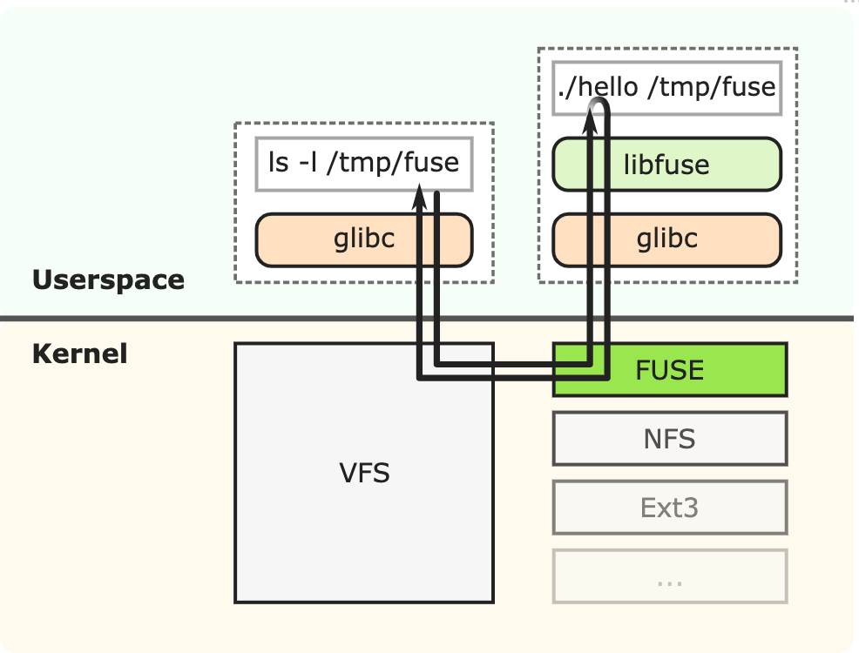
File System in Userspace (FUSE)
The idea of having a virtual/pseudo file systems existed since the dawn in computing. In fact, this is how *nix system operate aka “Unix philosophy”.
There are many things that can be described by “file system” some of them is remote (e.g., azure blobs as files), some of them is local (e.g., app api as files).
If we must build a new file system kernel modules for each we will end up with an uncontrollable mess. Enter FUSE that consists of two components:
Kernel module, mainlined and maintained as part the upstream kernel.
Userspace application that wraps libfuse (you implement an interface and plug-it into libfuse).
The kernel module communicate with a userspace process specifically the libfuse via a ring buffer which inturn calls a custom interface that fulfills the request (e.g., call a network server, call an endpoint etc).
FUSE is prolific. GlusterFS and SSHFS among others that are implemented using FUSE. libfuse has bindings for almost all the programming languages out there.
FUSE is also capable of operating as a block device. But the details is left as an exercise for the you.
https://engineering.facile.it/blog/eng/write-filesystem-fuse/

Slide 22
Network Block Device (NBD)
While FUSE focuses on the file system NBD focuses on forwarding block device calls over the network. It operates on similar fasion based on two components working in unison:
Kernel module that translates blkdev request fulfillment into a network calls to either a userspace process or a remote endpoint.
A fulfillment endpoint that implements NDB protocol.
The protocol is super simple read()/write() and other similar functions where each has an offset (maps to 512 blocks) and length in blocks.

Slide 23
Block Device Stacking
What is?
If you looked the way block device driver works you will notice they have exactly the same interface.
That means we can compose a stack (or chain) of a bunch of devices to add new features to existing devices without changing the device driver itself.
Example:
Stacking a caching device on top of an actual blk device means that we can cache more in the top layer and flow only the smallest number of reads needed from top layer to bottom layer. Similarly, encryption can be delivered the same way.
Because of the flexibility we can also get cleverer. We can stack a device that produces fake delays, errors on top of a healthy device for testing.
The two ways of doing it:
Device Mapper: dm-mapper is a kernel own device stacking framework. It has a kernel module and a userspace front end cli tool dmsetup.
Logical Volume Manager: LVM a kernel module and cli userspace front end that builds on top and uses dm-mapper to provide RAID, and striping functionalities.
Things to think about before using either.
TEST, TEST, TEST! (until fear turns into boredom) – caching for example is not as a straight-forward as it sounds. There are so many knops to configure and unlikely the default setup will fit your use-case. And yes, there are some use-cases where caching makes things slower.
RTFM ¯\_(ツ)_/¯ when dealing with storage systems data loss is always a possibility. So before jumping in into configuring lvm or device mapper make sure that you have read and understand all the edge cases.

Slide 24
Userspace IO (UIO) + Bonus Bifurcated Drivers
UIO
What is?
A framework allowing device driver to expose a consistent IO interface to userspace app.
Build a kernel module that register one or more /dev/uioX devices.
Userspace applications then use regular syscalls to read(2) intrrupts from the uio driver and mmap(2) to map device memory into userspace.
For more details: https://www.kernel.org/doc/html/v4.12/driver-api/uio-howto.html
For example, DPDK falls back to UIO if all other faster paths fail.
Bifurcated Drivers
What is? Is a hardware (NICs, exclusively) supported method of having two s/w drivers attached to the NIC the nic h/w performs the filtering (or queue splitting).
Bifurcation allows DPDK (and the likes) to sniff packets (full kernel bypass) off the kernel into the userspace for processing.

Slide 25
Networking: Kernel Bypass (Partial)
What is?
The simplest form of userspace partial kernel bypass is raw sockets.
Raw sockets enables use to send and receive packets over frames.
How To:
Create a tap device if you are planning to send frames.
Create a tun device if you are planning to send IP packets.
Manually create packets or frames then send or receive them as needed. Most use cases are either testing, pen-testing or some form of testing.
A complete example can be found here: https://www.binarytides.com/raw-sockets-c-code-linux/
Some higher-level languages have simpler frameworks to abstract away all the gnarly details of packet creation, serialization and checksum mgmt such as google gopacket.

Slide 26
The many ways of networking kernel bypass
Why? The kernel is designed to do a lot of things. Which tend to not perform well if it needs to only do one thing. If you are performing traditional userspace socket-listening then yes you need the entire kernel for a lot of reasons. But if you are trying to build fast routing/switching/LB/FW/offload data path then probably stock kernel toolset will not be the best performant for your use-case.
We have covered kernel bypass in networking session at length. We will avoid duplication here. For further read https://blog.cloudflare.com/kernel-bypass/

Slide 27
Things we didn’t talk
Userspace scheduling delegation
Network device stacking/teaming
TCM/TCMU
NF userspace queues.

Slide 28
Thank You!
And some closing words.

